Slide 1
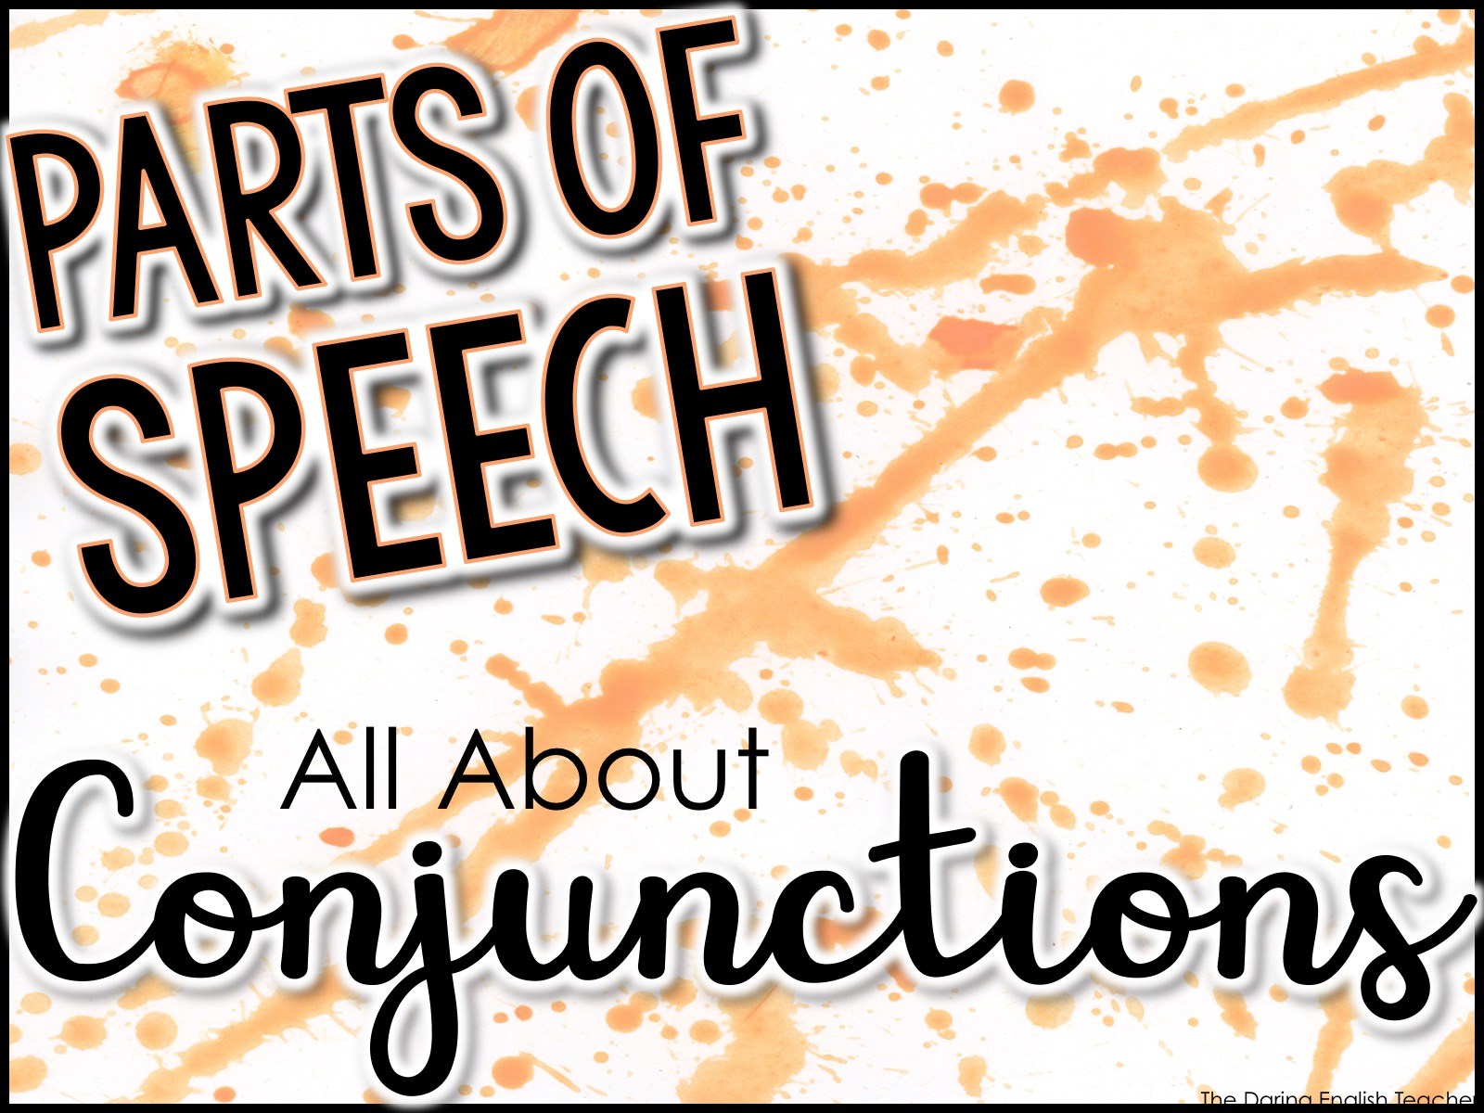
Parts of Speech
All About
Conjunctions

Slide 2
Conjunctions
A conjunction is a word that connects parts of a sentence together.
There are several kinds of conjunctions:
Coordinating conjunctions
Subordinating conjunctions
Correlative conjunctions
Conjunctive adverbs

Slide 3
Coordinating Conjunctions
Coordinating conjunctions connect words, phrases, and clauses of equal ranks.
There are 7 coordinating conjunctions.
Examples:
For, And, Nor, But, Or, Yet, So

Slide 4
F.A.N.B.O.Y.S.
Use the acronym F.A.N.B.O.Y.S. to remember coordinating conjunctions.
For
And
Nor
But
Or
Yet
So

Slide 5
F.A.N.B.O.Y.S.
For – it means because or since
And – it means in addition to; also
Nor – use this in a neither/nor pair
But – shows a contrast or exception
Or – shows an alternative
Yet – an alternative for but
So – means as well or in addition

Slide 6
Coordinating Conjunctions
Use coordinating conjunctions when you are…
connecting two items.
connecting items (3 or more) in a series.
connecting 2 main clauses.

Slide 7
Coordinating Conjunctions
Connecting two items.
Examples:
I like to eat tortas and enchiladas.
He is neither bright nor intelligent.
My younger brother is rather intelligent but quite annoying.
Do not use a comma when you connect two items that are not independent clauses.

Slide 8
Coordinating Conjunctions
Connecting items (3 or more) in a series.
Examples:
I like to run, swim, and hike.
After a long day at the office, my dad likes to take his shoes off, relax, and watch television.
Notice the comma placement here. Use a comma when you connect items in a series.

Slide 9
Coordinating Conjunctions
Connecting 2 main clauses.
A main clause is a sentence that can stand on its own.
Examples:
I want to go to the store and buy a new notebook, but I don’t have any money.
It would be nice to go to Florida, for I have always wanted to see the Keys.
When connecting two main clauses, always use comma conjunction.

Slide 10
Coordinating Conjunctions
Connecting 2 main clauses.
A main clause is a sentence that can stand on its own.
Practice – Connect these clauses:
Main clause 1: I like to eat pickles.
Main clause 2: I loathe cucumbers.
I like to eat pickles, but I loathe cucumbers.

Slide 11
Coordinating Conjunctions
Connecting 2 main clauses.
A main clause is a sentence that can stand on its own.
Practice – Connect these clauses:
Main clause 1: She needs to go grocery shopping.
Main clause 2: She needs to buy a dozen eggs.
She needs to go grocery shopping, for she needs to buy a dozen eggs.

Slide 12
Coordinating Conjunctions
Connecting 2 main clauses.
A main clause is a sentence that can stand on its own.
Practice – Connect these clauses:
Main clause 1: It is already Spring.
Main clause 2: The bear is still in hibernation.
It is already Spring, yet the bear is still in hibernation.

Slide 13
Coordinating Conjunctions
Connecting 2 main clauses.
A main clause is a sentence that can stand on its own.
Practice – Connect these clauses:
Main clause 1: We can cook fajitas for dinner.
Main clause 2: We can order pizza.
We can cook fajitas for dinner, or we can order pizza.

Slide 14
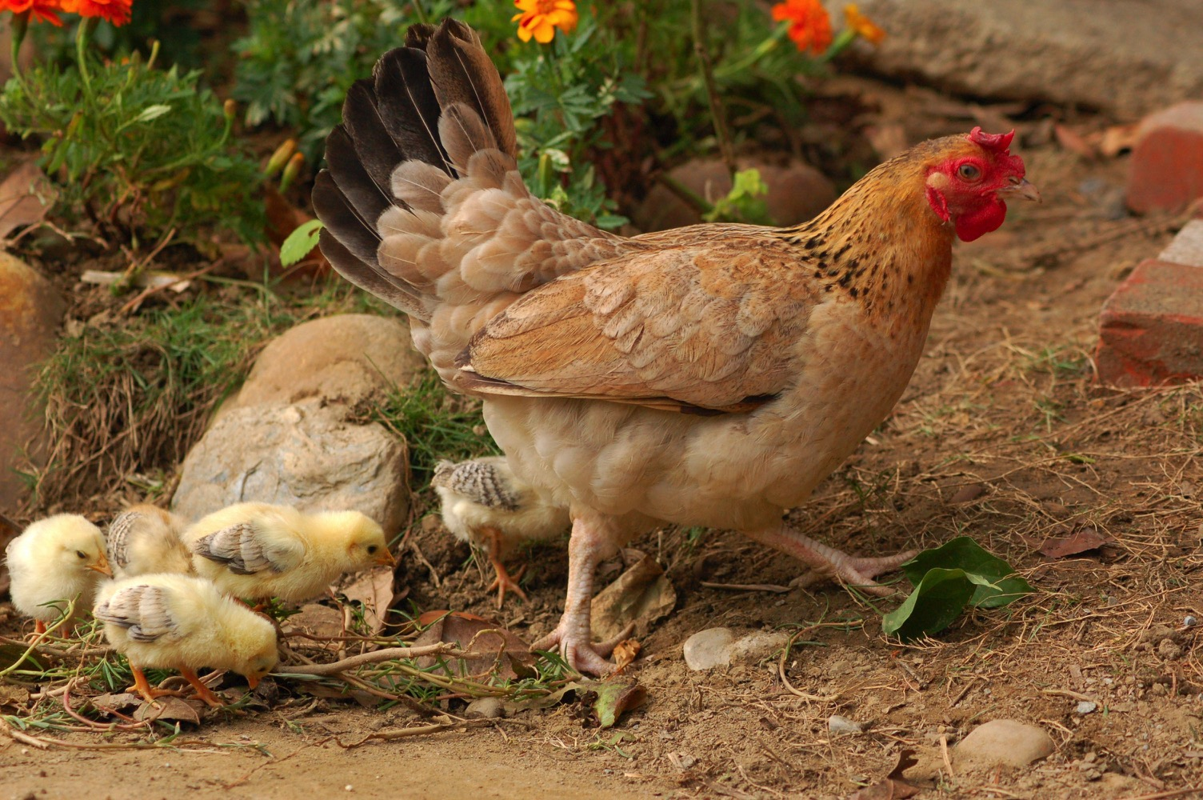
Using the picture as a prompt, write a sentence that includes a coordinating conjunction.

Slide 15

Using the picture as a prompt, write a sentence that includes a coordinating conjunction.

Slide 16
Subordinating Conjunction
A subordinating conjunction is a conjunction that introduces a subordinate clause and connects it to a main clause to create a complex sentence.
A subordinate clause is a sentence fragment that relies on the main clause (complete sentence) of the sentence.
When the phone rang, she answered it quickly.
subordinate clause

Slide 17
Subordinating Conjunction
A subordinating conjunction connects the two ideas and establishes an order of importance between the two clauses.
Examples:
after, before, because, as, when, until, whereas, whether, while, unless, etc.

Slide 18
Subordinating Conjunction
More examples: (notice the punctuation)
When the bell rang, the students packed up their belongings and left the room.
subordinating conjunction: When
subordinate clause: When the bell rang…
Notice: Use a comma to separate the clauses when the subordinate clause comes first.

Slide 19
Subordinating Conjunction
More examples: (notice the punctuation)
The students packed up their belongings and left the room when the bell rang.
subordinating conjunction: when
subordinate clause: …when the bell rang
Notice: There is no comma when the subordinate clause comes after the main clause.

Slide 20
Subordinating Conjunction
More examples: (notice the punctuation)
Even though Susana studied all night for the test, she still failed the exam.
subordinating conjunction: Even though
subordinate clause: Even though Susana studied all night for the test,…
Notice: Use a comma to separate the clauses when the subordinate clause comes first.

Slide 21
Subordinating Conjunction
More examples: (notice the punctuation)
Susana still failed the exam even though she studied all night for the test.
subordinating conjunction: even though
subordinate clause: …she studied all night for the test.
Notice: There is no comma when the subordinate clause comes after the main clause.

Slide 22

Using the picture as a prompt, write a sentence that includes a subordinating conjunction.

Slide 23

Using the picture as a prompt, write a sentence that includes a subordinating conjunction.

Slide 24
Correlative Conjunction
A correlative conjunction is a paired conjunction that links words, phrases, and clauses.
Examples:
both...and…
neither…nor…
either…or…
not…but…
not only…but also…

Slide 25
Correlative Conjunction
More examples:
I need to remember both my toothbrush and my toothpaste for the trip.
Neither the tacos nor the burrito sound good to me.
We can either go swimming or ice skating.
Mrs. William not only assigned a five-page essay, but also required us to present the information to the class.

Slide 26
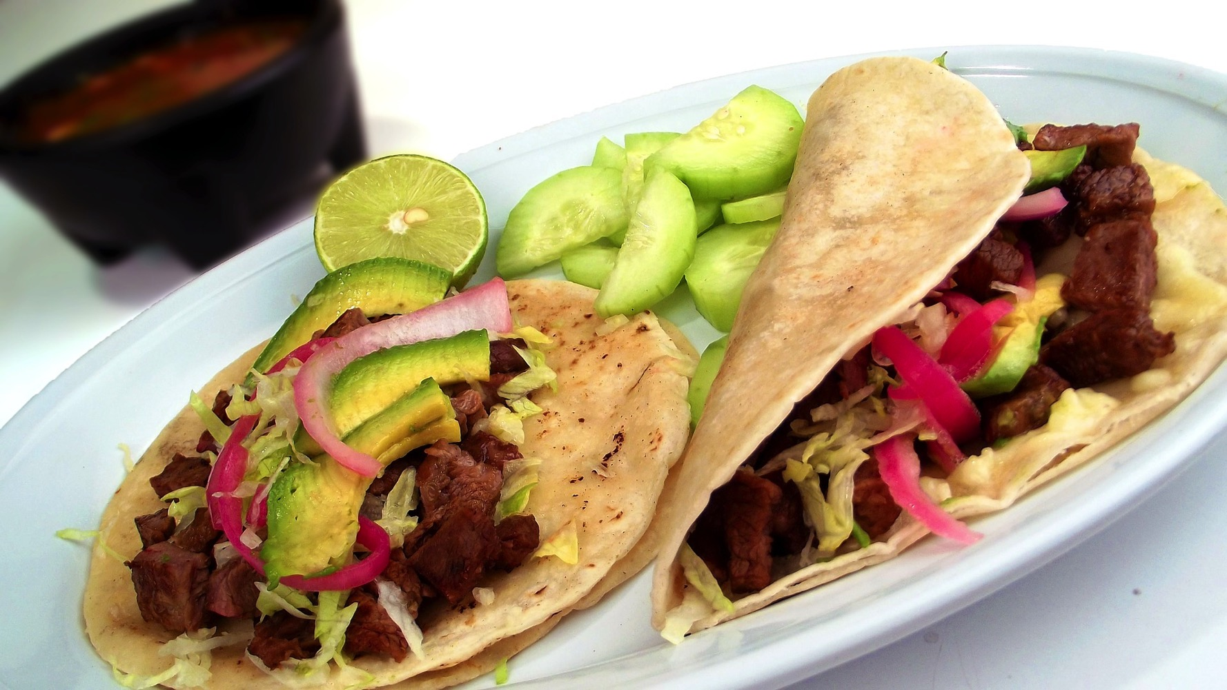
Using the picture as a prompt, write a sentence that includes a correlative conjunction.

Slide 27

Using the picture as a prompt, write a sentence that includes a correlative conjunction.

Slide 28
Conjunctive Adverbs
Conjunctions combine words, phrases, and clauses to each other.
An adverb can also connect words, phrases, and clauses. These adverbs are called conjunctive adverbs.
Examples:
also, besides, however, nonetheless, likewise, otherwise, similarly, next, etc.

Slide 29
Conjunctive Adverbs
Conjunctive adverbs have two different functions:
connecting two main clauses.
introduce, interrupt, or conclude just one main clause.

Slide 30
Conjunctive Adverbs
Connecting 2 main clauses.
A main clause is a sentence that can stand on its own.
Examples:
My history teacher assigned us a book report; however, we are able to select any book we would like.
When connecting two main clauses with a conjunctive adverb, always separate the first main clause with a semi-colon and then place a comma after the conjunctive adverb.

Slide 31
Conjunctive Adverbs
Connecting 2 main clauses.
A main clause is a sentence that can stand on its own.
Examples:
You must study for the test; otherwise, you will not pass the class.
When connecting two main clauses with a conjunctive adverb, always separate the first main clause with a semi-colon and then place a comma after the conjunctive adverb.

Slide 32
Conjunctive Adverbs
Connecting 2 main clauses.
A main clause is a sentence that can stand on its own.
Examples:
I will not be able to go to the concert tonight; therefore, I am selling my ticket.
When connecting two main clauses with a conjunctive adverb, always separate the first main clause with a semi-colon and then place a comma after the conjunctive adverb.

Slide 33
Conjunctive Adverbs
Introducing, interrupting, or concluding a main clause.
A main clause is a sentence that can stand on its own.
Examples:
Sam did not eat his green beans. He did eat his squash, however.
When the conjunctive adverb is placed at the end of a sentence, it is separated by a comma.

Slide 34
Conjunctive Adverbs
Introducing, interrupting, or concluding a main clause.
A main clause is a sentence that can stand on its own.
Examples:
Sam did not eat his green beans. However, he did eat his squash.
When the conjunctive adverb is placed at the beginning of a sentence, it is separated by a comma.

Slide 35
Conjunctive Adverbs
Introducing, interrupting, or concluding a main clause.
A main clause is a sentence that can stand on its own.
Examples:
Sam does not like green beans. His mother is determined, nevertheless, to have him eat them.
When the conjunctive adverb is placed in the middle of a sentence, it is separated by commas, unless it is a weak interruption.

Slide 36

Using the picture as a prompt, write a sentence that includes a conjunctive adverb.

Slide 37
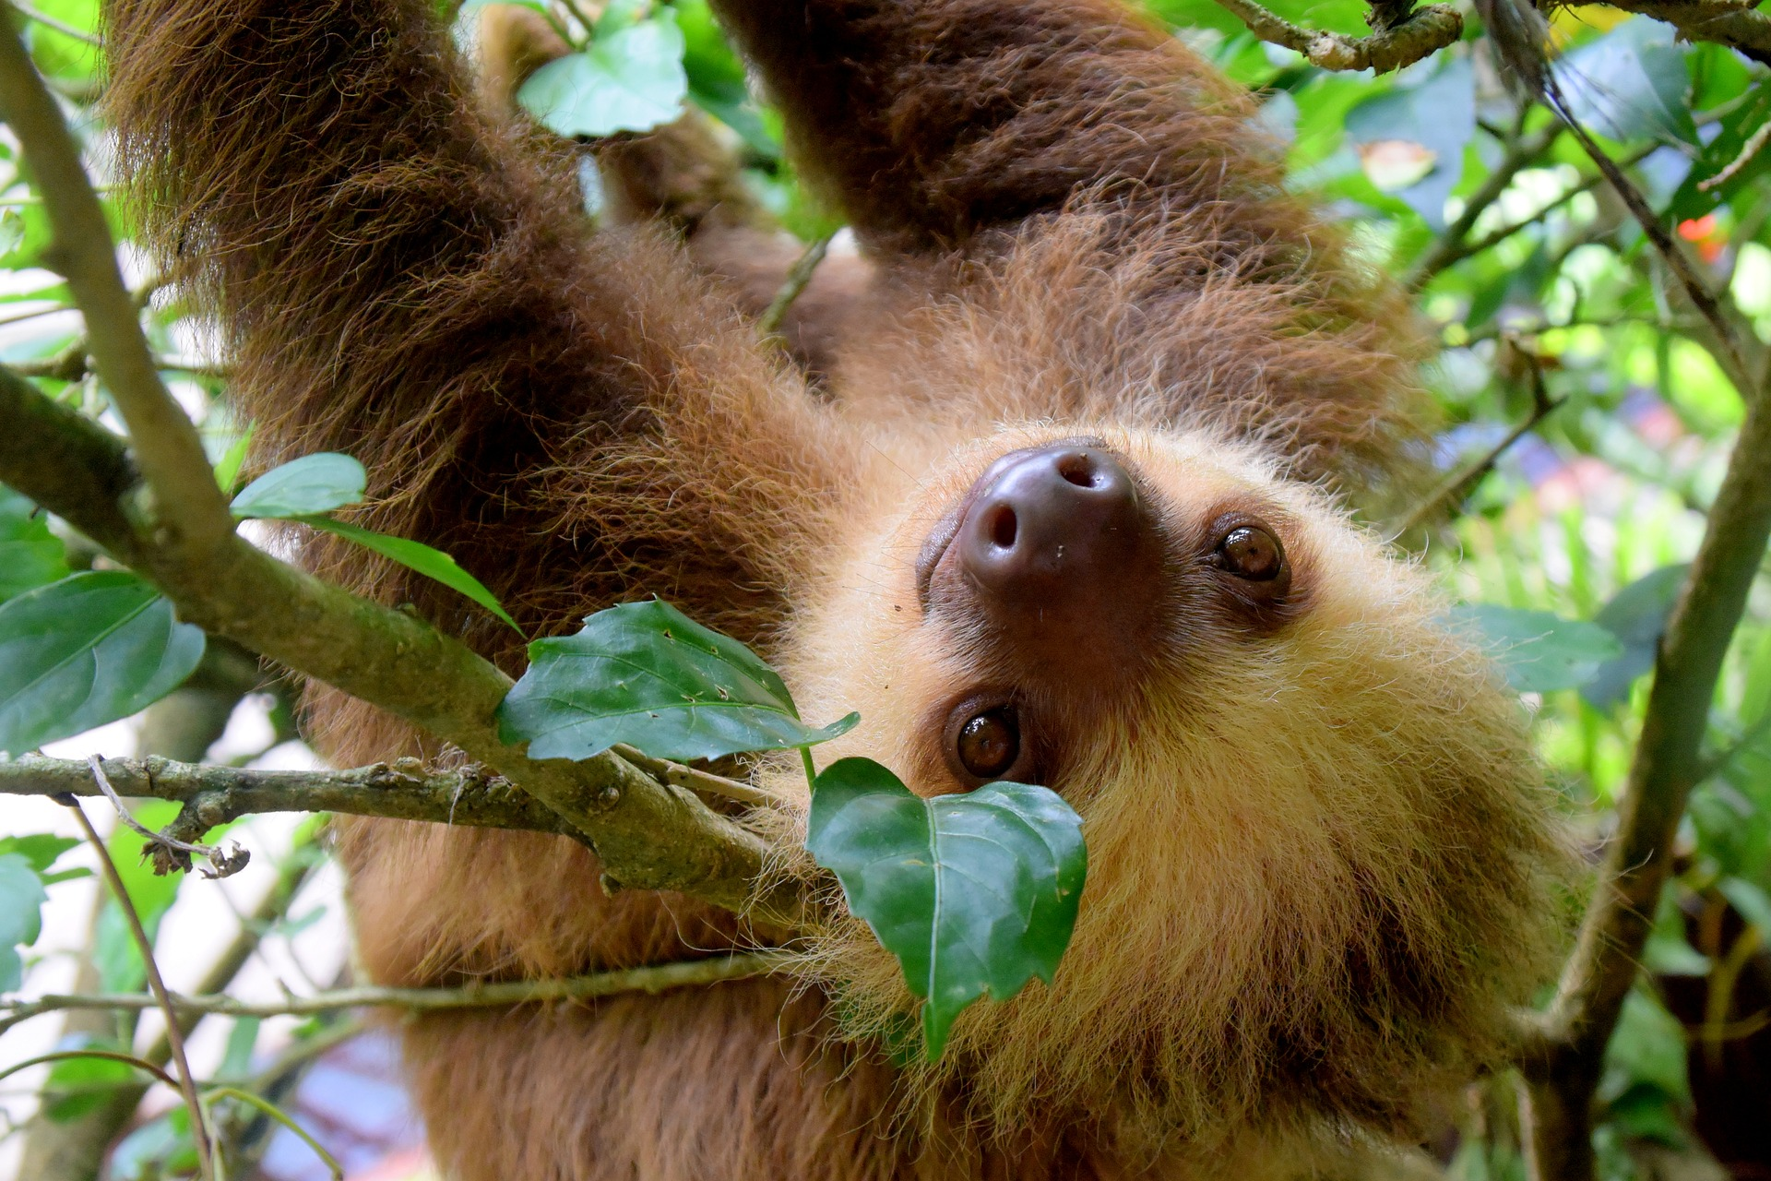
Using the picture as a prompt, write a sentence that includes a conjunctive adverb.

